Slide 1


Practical Theory Extension
Asieh Salehi¹, Michael Butler¹, Jean-Raymond Abrial²
University of Southampton¹
Marseille²
5th Rodin Workshop
2nd June 2014, Toulouse

Slide 2
Tutorial Overview
Part I, Asieh Salehi
Motivation
Introducing Theory Extension capabilities
Simple demo of the Theory plug-in
Part II, Michael Butler
Inductive definitions and proofs
Axiomatic definitions
Wrapping compound structures in data types
Hierarchical file example
Part III, Jean-Raymond Abrial
Well-Definedness, Fixpoint, Closure, Computation, Well-Ordering Theorem, Cantor-Bernstein Theorem, Axiomatisation of Real-Numbers

Slide 3
Motivation: Mathematical theories in Event-B
Core Rodin supports rich mathematical theories:
integers, sets, relations, functions …
But many problems require additional mathematical structures (e.g., lists, trees, graphs, reals)
These structures could be defined axiomatically (as an Event-B context), but
polymorphism is not supported
no direct way to extend the provers of Rodin
no direct support for ensuring soundness of new operator definitions and proof rules

Slide 4
Theory extension plug-in
Allow users to define new mathematical operators and data types
Allow users to add proof rules to Rodin prover
Rules may be used interactively
Rules may be added to automated tactics
Generate soundness POs for new definitions and proof rules

Slide 5
Forms of definition
Data types
Inductive polymorphic data types (e.g., lists, trees, …)
Axiomatic types (e.g., reals)
Polymorphic operator definitions
Direct definitions (e.g., sequences as integer functions)
Recursive definitions (e.g., operators on lists, trees, …)
Axiomatic definitions (e.g., axioms of real arithmetic)

Slide 6
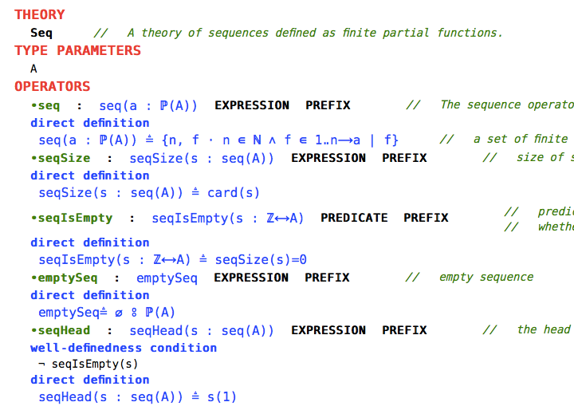
Sequence Theory

Slide 7
Forms of proof rule
Theorems (most general form)
Theorems can be instantiated manually in proof giving rise to additional hypotheses
Conditional rewrites:
lhs = rhs1, if C1
lhs = rhs2, if C2
Can be used manually or automatically
Inference rules:
Given P1, P2, … Infer Q
Induction: available for inductive types

Slide 8
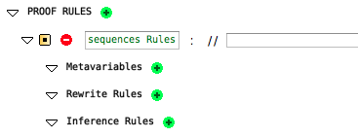
Demo Proof rules for Sequences

Slide 9
Job Queue Machine
MACHINE
JobQueue
SEES
C1
VARIABLES
queue
job
INVARIANTS
inv1 : job ⊆ JOB
inv2 : queue ∈ seq(job) // elements of queue are from job
EVENTS
INITIALISATION:
THEN
⚬ act1: queue ≔ emptySeq ›
⚬ act2: job ≔ ∅ ›
END

Slide 10
Soundness POs for proof rules
Theorems:
Soundness PO: theorem provable (from definitions and existing theorems)
Conditional rewrites:
Soundness PO: C1 ⇒ lhs = rhs1, …
Inference rules:
Soundness PO: P1 ∧ P2 ∧ … ⇒ Q

Slide 11
Proof of seq monotonic
Demo

Slide 12
Inductive datatypes
Peano
List
Trees

Slide 13
Visibility and Scoping: Deploying a theory
An individual theory consist of a collection of definitions and proof rules
The first step to make the definitions and proof rules available to use is deploying a theory.

Slide 14
Visibility and Scoping: Importing other theories
A theory can import other deployed theories
Hierarchy of theories:
Importing theory inherits definitions from the imported theory
Importing theory can extend the parent definitions
Conflicting validation applied (e.g., same name elements is not allowed )
A theory can import a local or global theory

Slide 15
Visibility and Scoping: Theory Path
A theorypath is a tool to introduce the deployed theories in a project scope
A theorypath can imports deployed (local/global) theories
A machine/context accesses (local/global) theories imported directly or indirectly by a theorypath within the same project as the machine/context

Slide 16
Visibility and Scoping: Example
P1
P2
P3
TheoryPath
imports
P1.T1
P3.T4
T2
T3
import
T4
T1
import
Theories T1, T2, T3 and T4 are visible in P1 via TheoryPath

Slide 17
Visibility and Scoping: Colour Coding
White : a new and un-deployed theory
A white theory is not accessible to be imported either in another theory or in a theorypath
Green : a deployed updated theory
A green theory is deployed and updated.
Amber : a deployed out-dated theory
an amber theory is modified after deployment; the deployed version of the theory is not sync with the current state of the theory.

Slide 18
Tree structured file store
Objects can be files or directories
Unique root object
Each object has a parent (except root)
No loops in the structure
Each object reachable from root
Operations:
create object,
add object,
delete object (incl directory),
move object (incl directory),
copy object (incl directory)

Slide 19
No-loop property
@inv1: parent ∈ objects \ {root} → objects
@inv2: parent* ∩ id = { }
Invariant 2 is not easy to work with.
Instead we use Well-foundedness:
wf(R) == ∀s . s ⊆ R⁻¹[s] ⇒ s = { }
@inv3: wf(parent)
inv2 becomes a theorem that follows from inv3.

Slide 20
Graph based tree theory
Tree structure represented by
Set of nodes n
Root node r
Parent function p
Wrap these as a data type (polymorphic on nodes)
TreeType( nodes:n, root:r, parent:p )
Define a validity predicate
ValidTree(t) ==
parent injective on nodes
no loops in parent
root is the ancestor of all other nodes
Define operators on tree structures
addChild, addSubtree, …
Use theory to specify a machine model of a file system

Slide 21
Concluding
Summary:
Added support for user-defined theories and proof rules in seamless way with soundness POs
Usage scenarios:
Types and operators identified and defined
Basic proof rules identified and proved
soundness POs can uncover errors in definitions and rules
Usage of new theories in models identifies need for additional proof rules
These are added to the theories

